Slide 1

“TEXT EDITOR”
Submitted By
Tanweer Akhtar

Slide 2
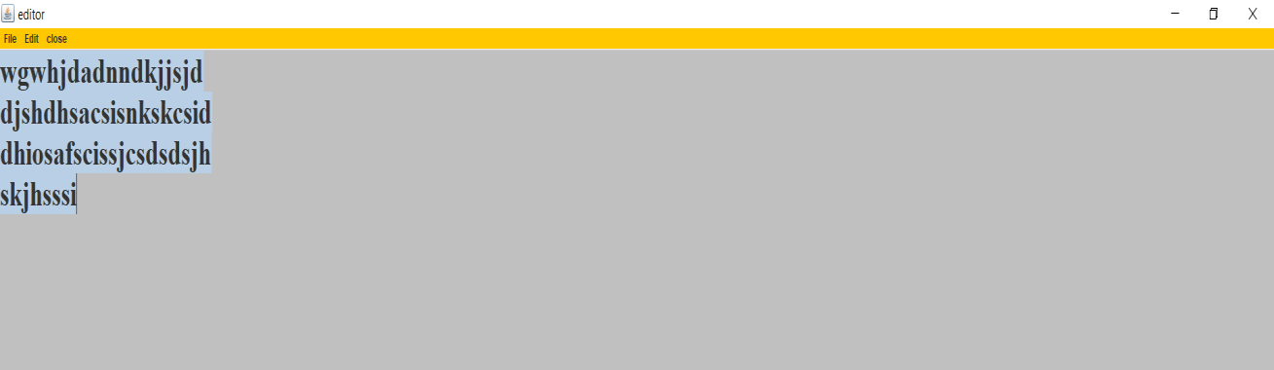
What is Text Editor????

Slide 3
Uses of Text Editor
A text editor is program that allows you to open, view, and edit plain text files
Text editors do not add formatting to text, instead focusing on editing functions for plain text.
Text editors are used by a wide variety of people, for a wide variety of purposes.
Text editor help you to give no. of advantage over word processor.

Slide 4
How to use text editor
First View Main window
This is the GUI of text editor it includes the dock under the menu bar and text space for
editing the text. The look and feel is default look of Operating system .

Slide 5
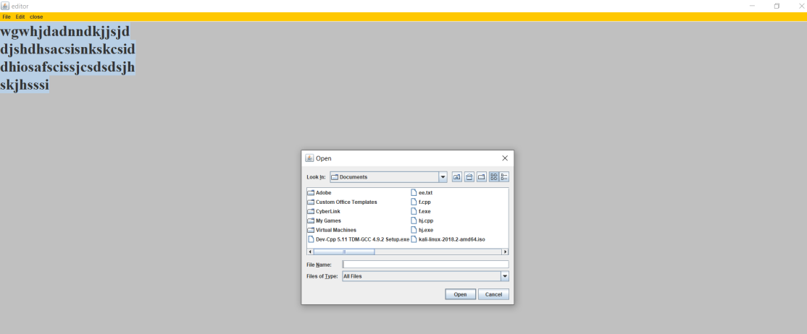
Second View :-.Opening a file
This window appears when we click on the open option on the Dock or in the file
menu The file menu is created using JMenu class.

Slide 6
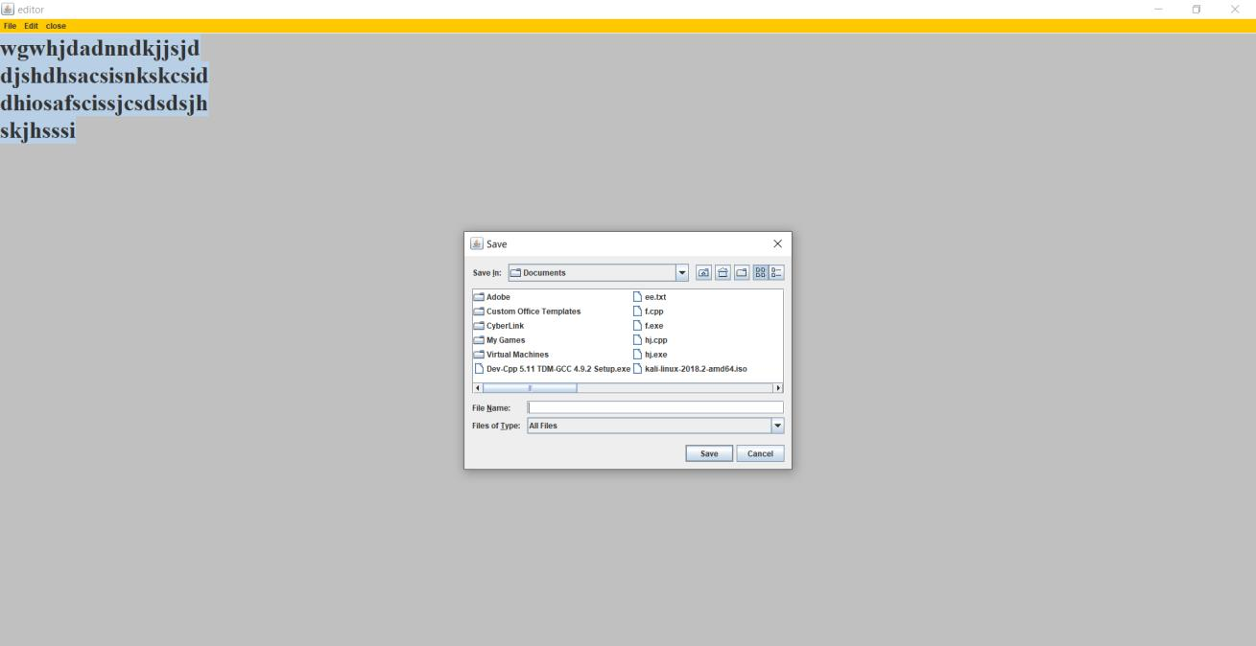
Third View Saving a file
This window appears when we want to save the file. The shortcut Ctrl+s do not work here so
we can do it using file menu or option on the Doc.

Slide 7
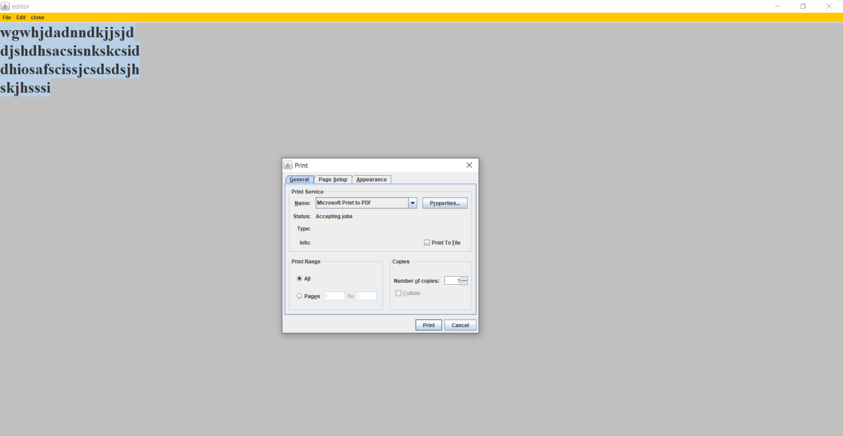
Fourth View Print a file
This window appears when we want to print the file. The shortcut Ctrl+p do not work here so
we can do it using file menu or option on the Doc.

Slide 8
Applications
This can be used for editing any code.
It is very much beneficial for the programmers.
For simple edits, it is often faster to make changes to a page using a text editor.
It can be used for Frontend designing(HTML, CSS).

Slide 9
THANK YOU

